Slide 1
Welcome
Project Batch : 178
Group : 2
Team Members :
Karthik A S
Esha Panse
Ashwini Roshan khandait
Akash neman
karthik sonawane

Slide 2
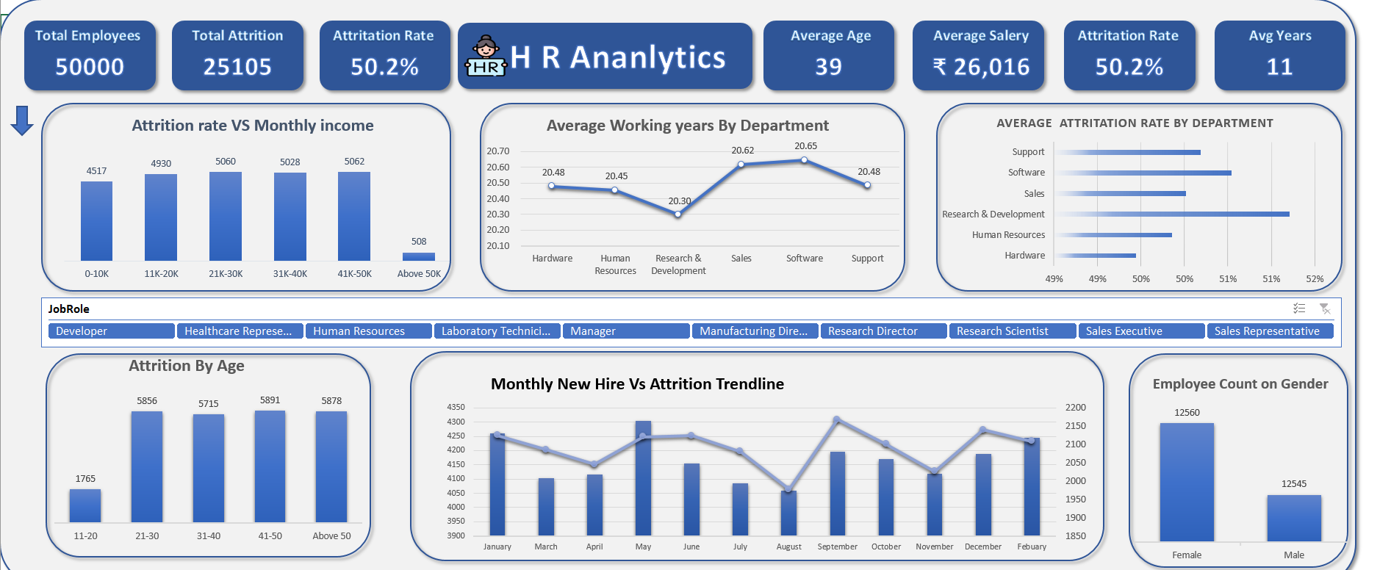
Excel Dashboard 1 :
We have analysed the given data and have built this interactive dashboard to present the in sites of the data to understand the attrition rate and cause for it. And help the board to make data driven decision to improve work experience of there employees. And build a strong family.

Slide 3
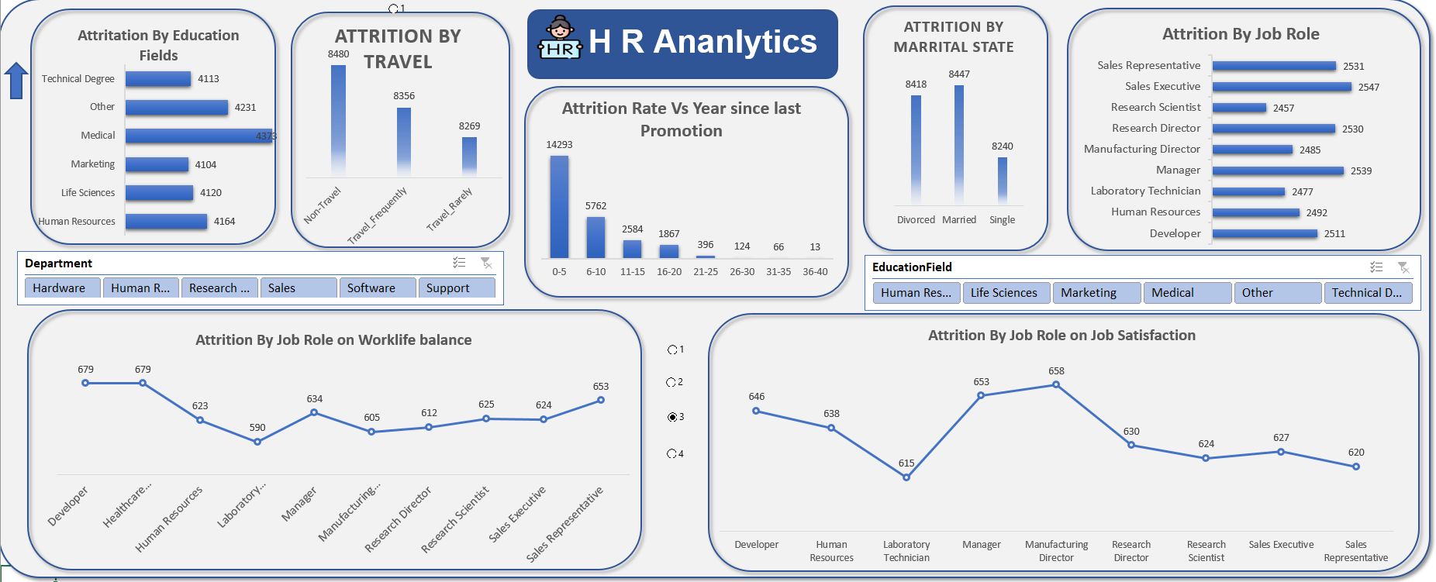
Excel dashboard 2 :
Formulas :
Pivot tables
Pivot charts
Vlookup
Nested if functions
5. Buttons

Slide 4
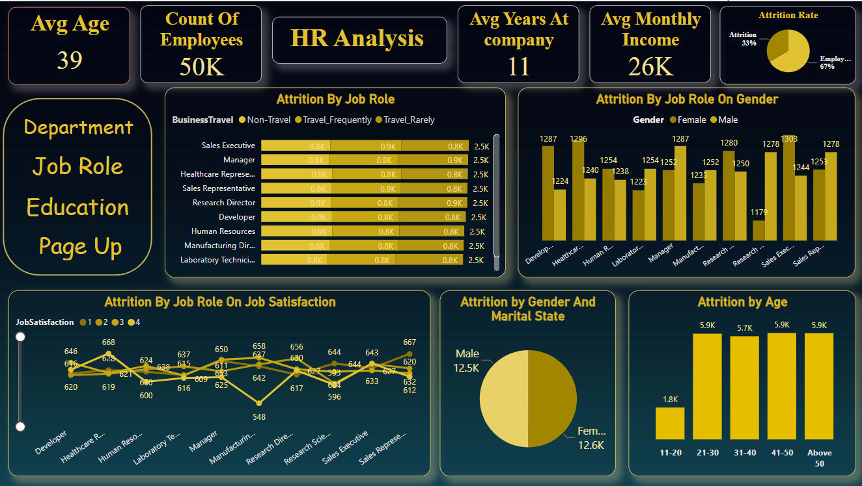
Power bi dashboard 1 :

Slide 5
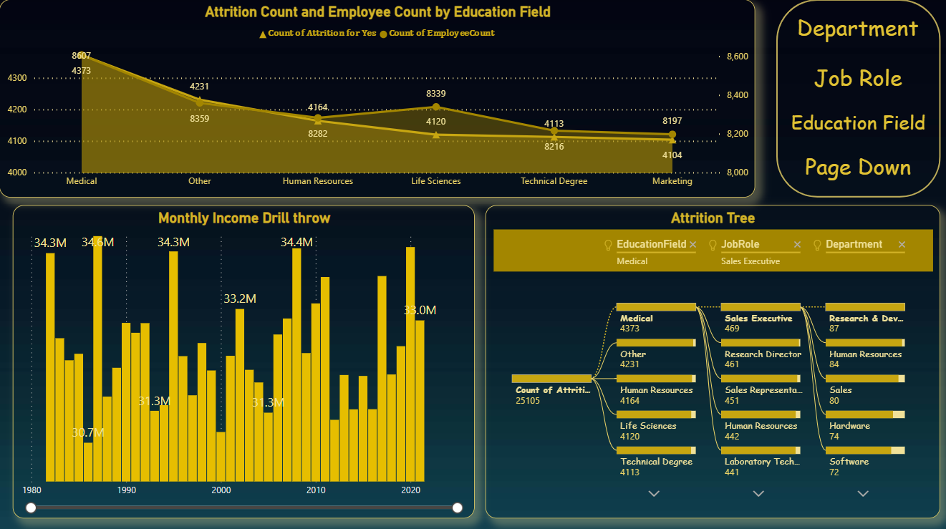
Power Bi dashboard 2 :

Slide 6
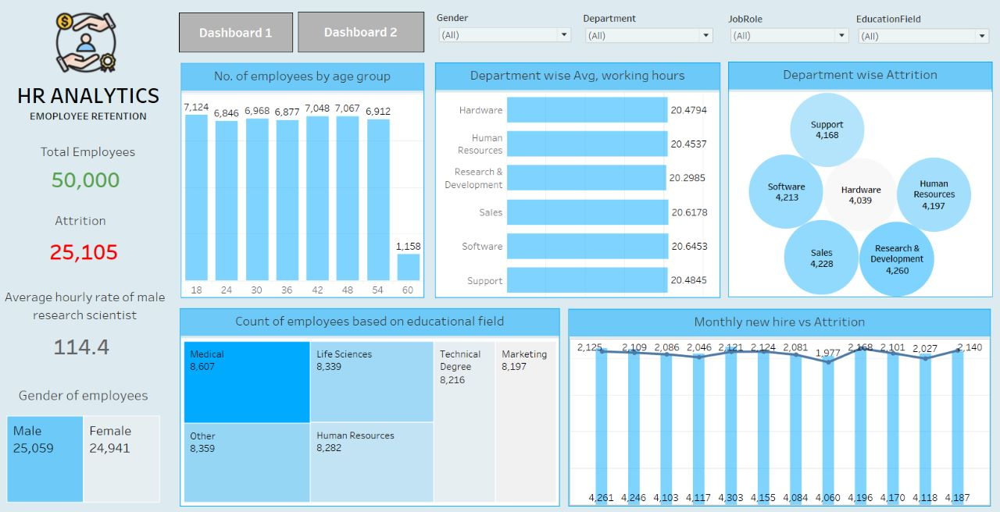
Tableau dashboard 1 :

Slide 7
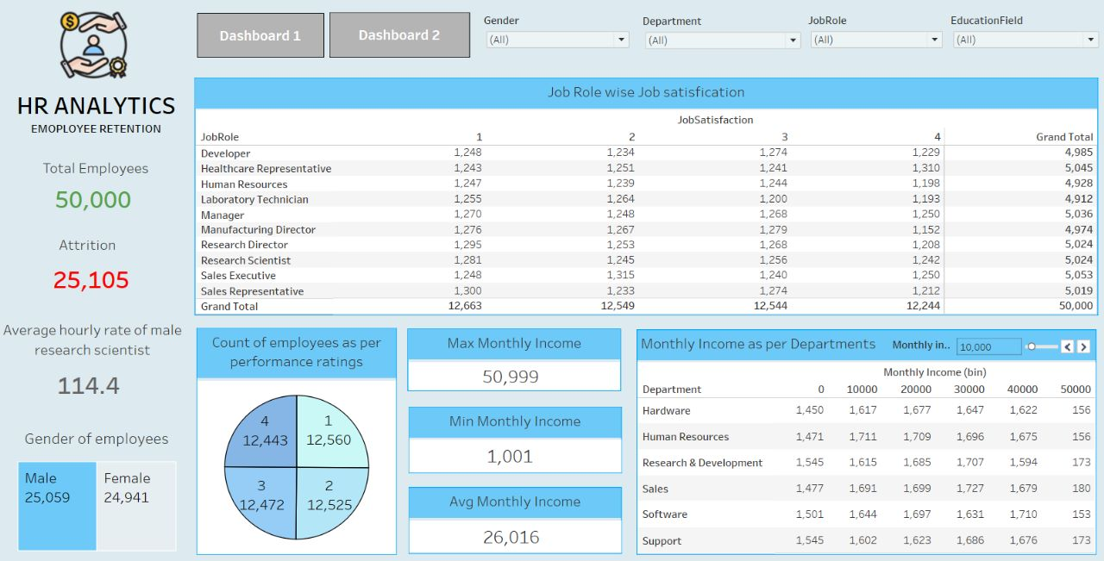
Tableau dashboard 2 :

Slide 8
SQL queries :
Attration By Department
SELECT Department,COUNT(*) AS COUNT FROM hr_1
WHERE Attrition = 'Yes'
GROUP BY Department
ORDER BY COUNT DESC;
2.Attrayion By Gender.
SELECT Gender, COUNT(*) AS COUNT FROM hr_1
WHERE Attrition = 'Yes‘
GROUP BY Gender
ORDER BY COUNT DESC;
3. Attration RATE ON jobsatisification
SELECT JobSatisfaction, COUNT(*) AS COUNT FROM hr_1
WHERE Attrition = 'Yes‘
GROUP BY JobSatisfaction
ORDER BY COUNT DESC;

Slide 9
6. EMPLOYEE COUNT ON BY YEAR OF JOINING
SELECT COUNT(*) AS COUNT , Year_of_Joining FROM hr_2
INNER JOIN hr_1ON hr_1.EmployeeNumber = hr_2.Employee_ID
GROUP BY Year_of_Joining
ORDER BY COUNT DESC
LIMIT 5;
5. Attration RATE ON Department WITH SALARY
SELECT COUNT(*),Department,SUM(MonthlyIncome) AS SUM FROM hr_1
INNER JOIN hr_2ON hr_1.EmployeeNumber = hr_2.Employee_ID
WHERE Attrition = 'Yes‘
GROUP BY Department;
6. EMPLOYEE COUNT ON BY YEAR OF JOINING
SELECT avg(MonthlyIncome) AS salary , Department FROM hr_2
INNER JOIN hr_1ON hr_1.EmployeeNumber = hr_2.Employee_ID
GROUP BY Department
ORDER BY salary DESCLIMIT 5;

Slide 10
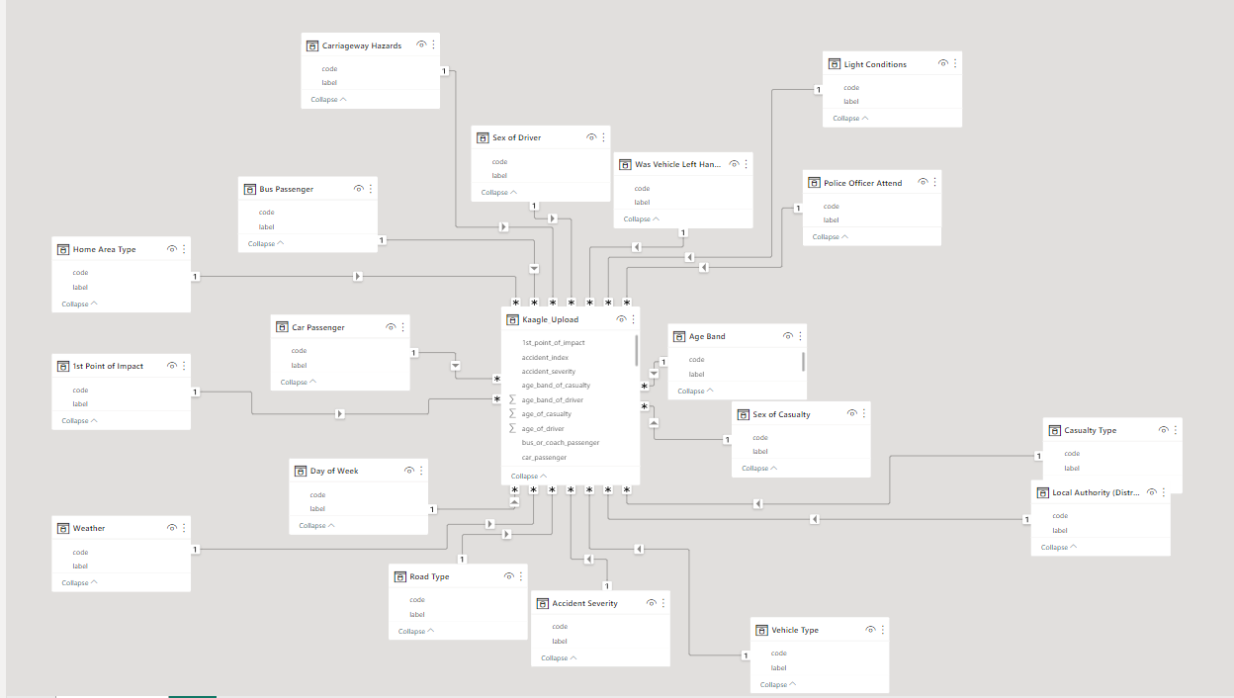
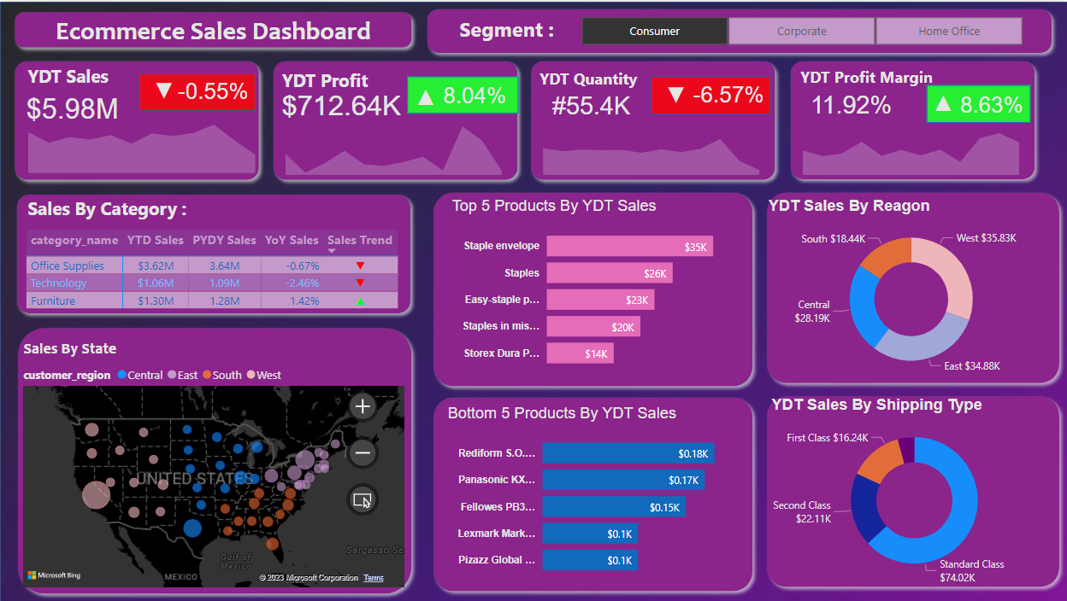
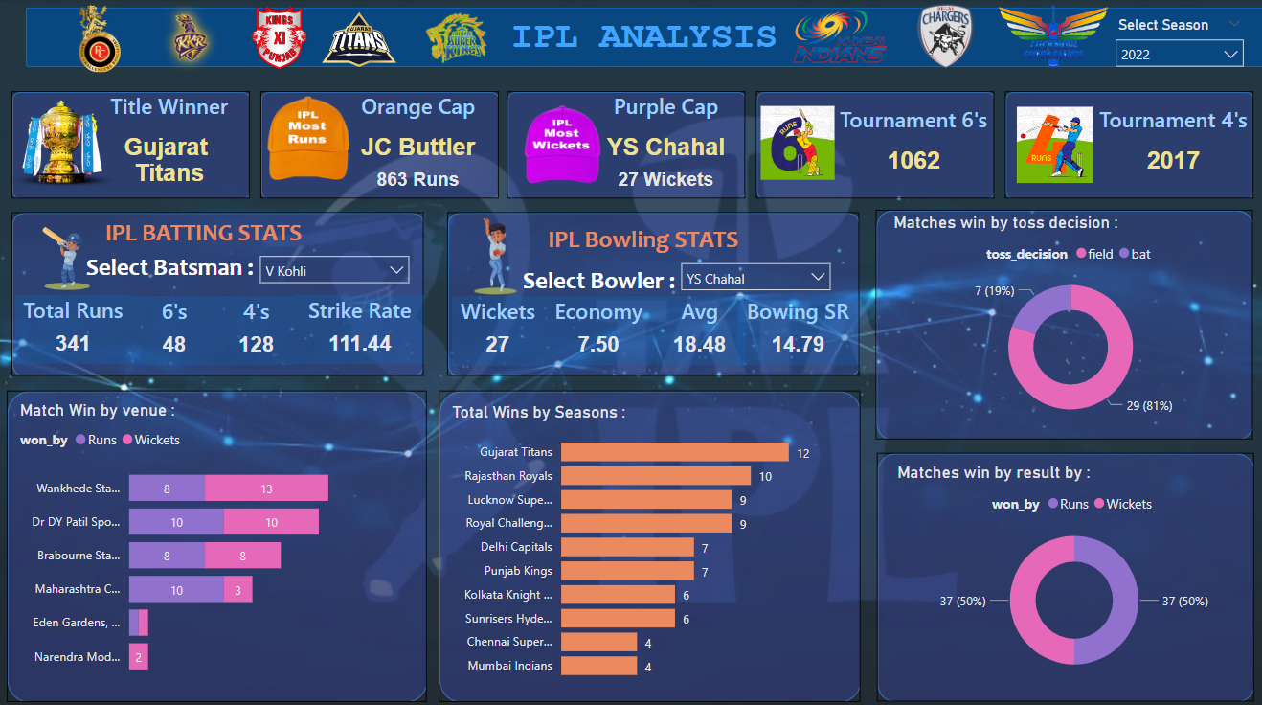
Thank You

